Slide 1
Subscription Tracker
Luke Hallinan

Slide 2
Aims & objectives
The aim of this project is to create a web application to track a users subscription services
It will give the user information about their active subscriptions
As well as statistics for spending
Find recurring subscription payment
Use data to generate recommendations

Slide 3
Why
Popularity
$57.0 million in 2011
$2.6 billion in sales in 2016
Most common are media services
These account for 46% of subscriptions
Costs
On average consumers underestimated how much they were spending
Forgotten
42% of people have services that they forgot they are even subscribed too

Slide 4
Technologies
JavaScript, HTML, CSS
Express JS
Node.JS
PostgreSQL
Docker
Python

Slide 5
System Architecture
Architecture
Database
The application uses the Model View Controller architecture
Split into client, server and database
Python is used for recommendations
PostgreSQL database
Running on docker containers

Slide 6
Research
Current Applications
Some popular applications are Rocket Money, Trim and TrackMySubs
Each has a different way of functioning
Common Features
Current subscriptions / bills page
Monthly spending
Calendar of upcoming payments
Alerts for next payments (email / text)
Manually added subscriptions
Additional Features
Find recurring payments / subscriptions
Cancel subscriptions

Slide 7
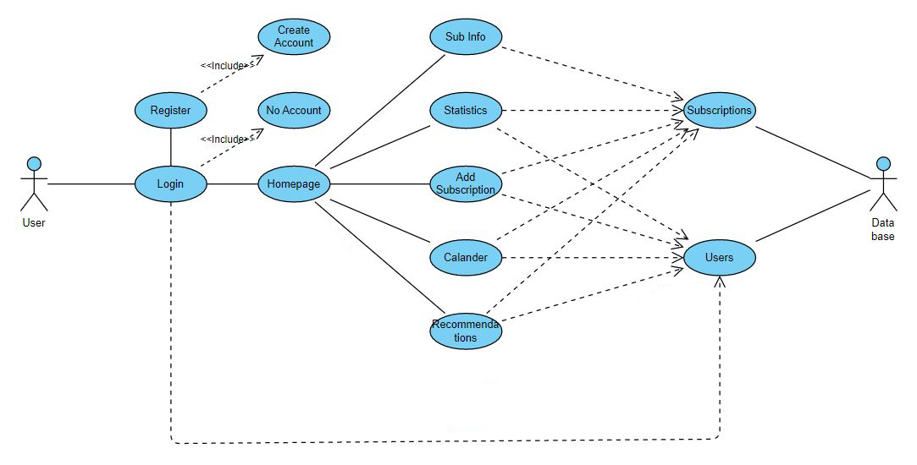
Requirements Capture
Include common functionality
Persistent data storage
Subscription importing
Data analytics

Slide 8


Slide 9
Project Complexity
Finding Subscriptions
Using an excel exported bank statement to search for and add subscriptions
Data Analytics / Recommendations
Data gathered will be used for recommending users other subscriptions
Data can also be used for marketing purposes

Slide 10
Project Complexity
User x User Matrix
Compares users with similar demographics
Checks subscriptions of these users
Recommends most common
Item x Item Matrix
Compares user subscriptions with similar types
Recommends similar subscriptions

Slide 11
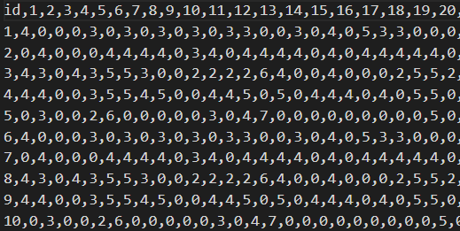
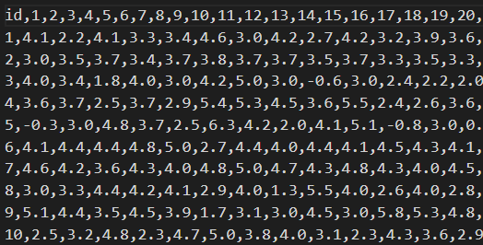
Project Complexity
User x Item Matrix
Checks subscription ratings
Estimate other ratings for users
Recommend highest rating for user

Slide 12
Testing
Feature testing
Database testing
Usability testing
Recommendation testing

Slide 13
Recommendation testing

Slide 14
Demo
Demo of site progress
I will now walk though a demo of the web app
Parts
Different pages
Database functionality
Recommendations

Slide 15
Thank You Any Questions?

